Slide 1
The Project Approach
Data Gathering
Crime Data – Government City Website.
Data Processing
Reviewed the files and performed Data Munging and Data Wrangling tasks using Python. Some of them include.
Data Visualizations
Converted the CSV files to Data Frame using Pandas
Generated the necessary Bar Stacked Charts to represent Crime using Matplotlib.
Housing – Zillow, Government Website to get the unemployment Rate and Federal Interest Rates.
Weather - Data Market
The data was obtained from various sources. The data captured was in the CSV format. Major sources include.
Jobs - Kaggle
finalized the Offence Type for Crime Data. Dropped the unnecessary columns.
Separated the Housing Data for the selected cities
The Data Visualizations and the necessary information was presented via a User Interface developed using Bootstrap, HTML and JavaScript
Generated Comparison charts for Housing using Plotly
Used Machine learning to predict the House prices for the selected cities.
Business Objective
Our analysis would provide a snap shot to an IT professional wanting to move to a city of his/her choice to seek Job opportunities primarily in the Data Analytics field . The selected cities include Austin, New York City and San Francisco. The factors taken into account which would drive the decision.
Demographics
Weather
Housing
Crime
Transportation
Major Companies
IT Jobs available
Data Analysis Tools Used
Python
Matplotlib
Pandas
Plotly
Bootstrap, HTML
JavaScript
Machine Learning

Slide 2
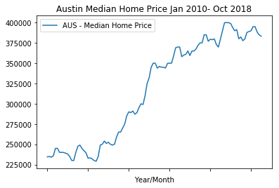
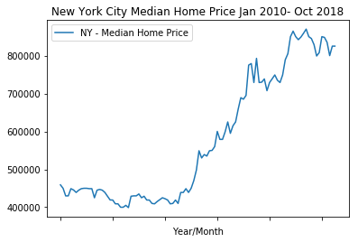
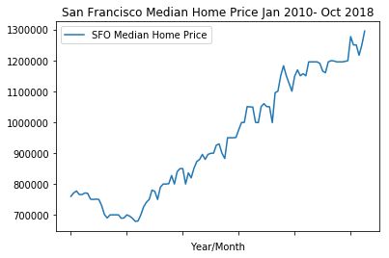
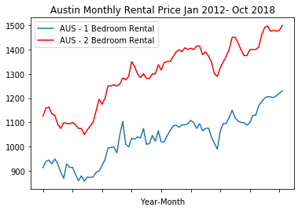
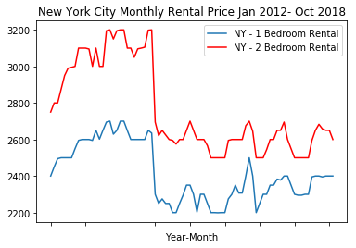
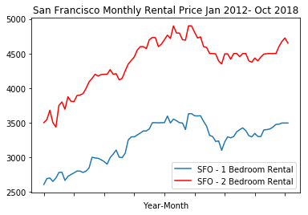
Data Visualizations - Housing

Slide 3
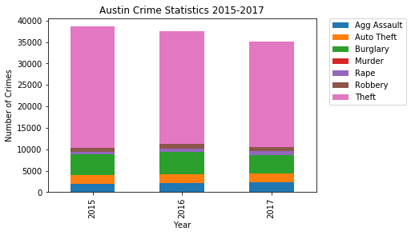
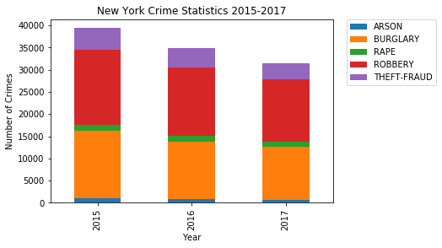
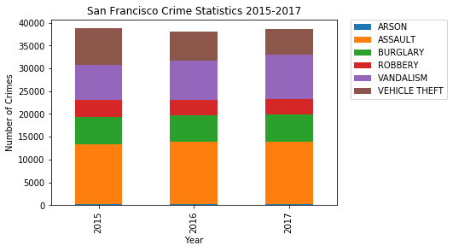
Data Visualizations - Crime

Slide 4
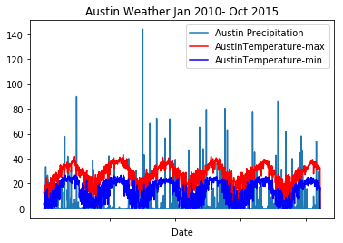
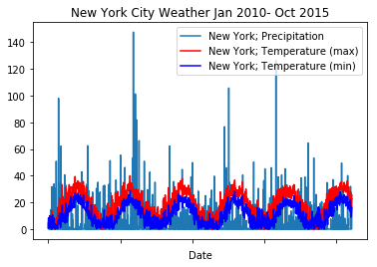
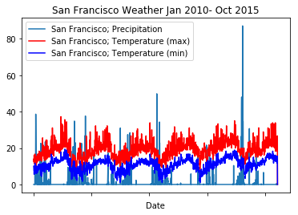
Data Visualizations - Weather

Slide 5
Challenges
1) Crime Data not available on a yearly basis for all the cities.
Resolved the issues by splitting large amounts of data to smaller files by writing a python program.
2) Current Weather data (2015-2018) for 3 cities was not readily available. Where it was the website required a fee to obtain the data.
Resolved: found the data from Data Market for 2010 – 2015.
3) Considerable time spent during user interface (UI) development.
Resolved : Figured out how to read a CSV file in JavaScript using Bootstrap.
4) Actual Housing data regarding Home sales for the selected cities was not available to predict Home prices using machine learning.
Resolved: Used Economic indicators like Federal Interest rate and Unemployment rate to predict the home price. Used Linear regression model in python.

Slide 6
Analysis
Crime is on the decline in New York. In Austin there is a slight improvement. In San Francisco no change is noticed.
The housing price is on the rise for all the 3 cities. The maximum appreciation is in New York (84%), followed by San Francisco (70%) and Austin (63%).
The Monthly Rent in San Francisco and Austin are on the rise. The increase is under 30%. In New York Renting an apartment this year is almost the same price as it was in 2010.
The most job openings for Data analytics are in San Francisco and New York City.

Slide 7
Resources
Crime Data
New York: https://data.cityofnewyork.us/Public-Safety/NYPD-Complaint-Data-Historic/qgea-i56i
San Francisco: https://data.sfgov.org/Public-Safety/Police-Department-Incident-Reports-Historical-2003/tmnf-yvry
Austin: https://data.austintexas.gov/
Housing: https://www.zillow.com/research/data/
Weather: https://datamarket.com/data/set/51w3/daily-weather-in-20-us-cities#!ds=51w3!8sfj=9.1.k:8sfk&display=line
Jobs: https://www.kaggle.com/sl6149/data-scientist-job-market-in-the-us

